Slide 1
Final Project Ideas
Which emails do I need to respond to?
Will money influence policy?
Do I have to request access?
Chad Iman

Slide 2

Problem: Using work emails from December 2016, determine whether or not a future email requires a response. I want a user to be able to return from vacation with a full inbox, and have their emails auto-prioritized by whether or not an email requires a response.
What emails do I need to respond to?

Slide 3

Data: Email text taken from work email and metadata from those emails. I will process the text of the email, looking for indicators such as whether the recipient’s name was found in the email. I will also use the metadata as features (hour email received, day of week, etc.).
What emails do I need to respond to?

Slide 4
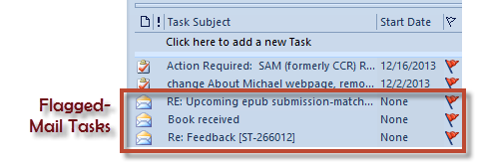
Hypothesis: Past email data will allow us to predict which unread emails require a response
What emails do I need to respond to?

Slide 5

Problem: Using policy outcome and financial contribution data from www.followthemoney.org from 2010 through 2016, determine the outcome of a policy proposal based on the amount of money contributed either in favor or against a proposed policy
Will money influence policy?

Slide 6
Data: Policy outcomes as well as financial contributions both in favor of and against those policies at the time that they were proposed
Will money influence policy?

Slide 7
Hypothesis: Financial contributions will allow us to predict the outcome of a proposed policy
Will money influence policy?

Slide 8

Problem: Using existing employee security profiles and application access, determine access and security profiles for similar employees. I would want a new employee to be able to join a company, and automatically have systems accessed processed.
Do I have to request access?

Slide 9
Data: Employee job title, function, applications access, and security profile
Do I have to request access?

Slide 10
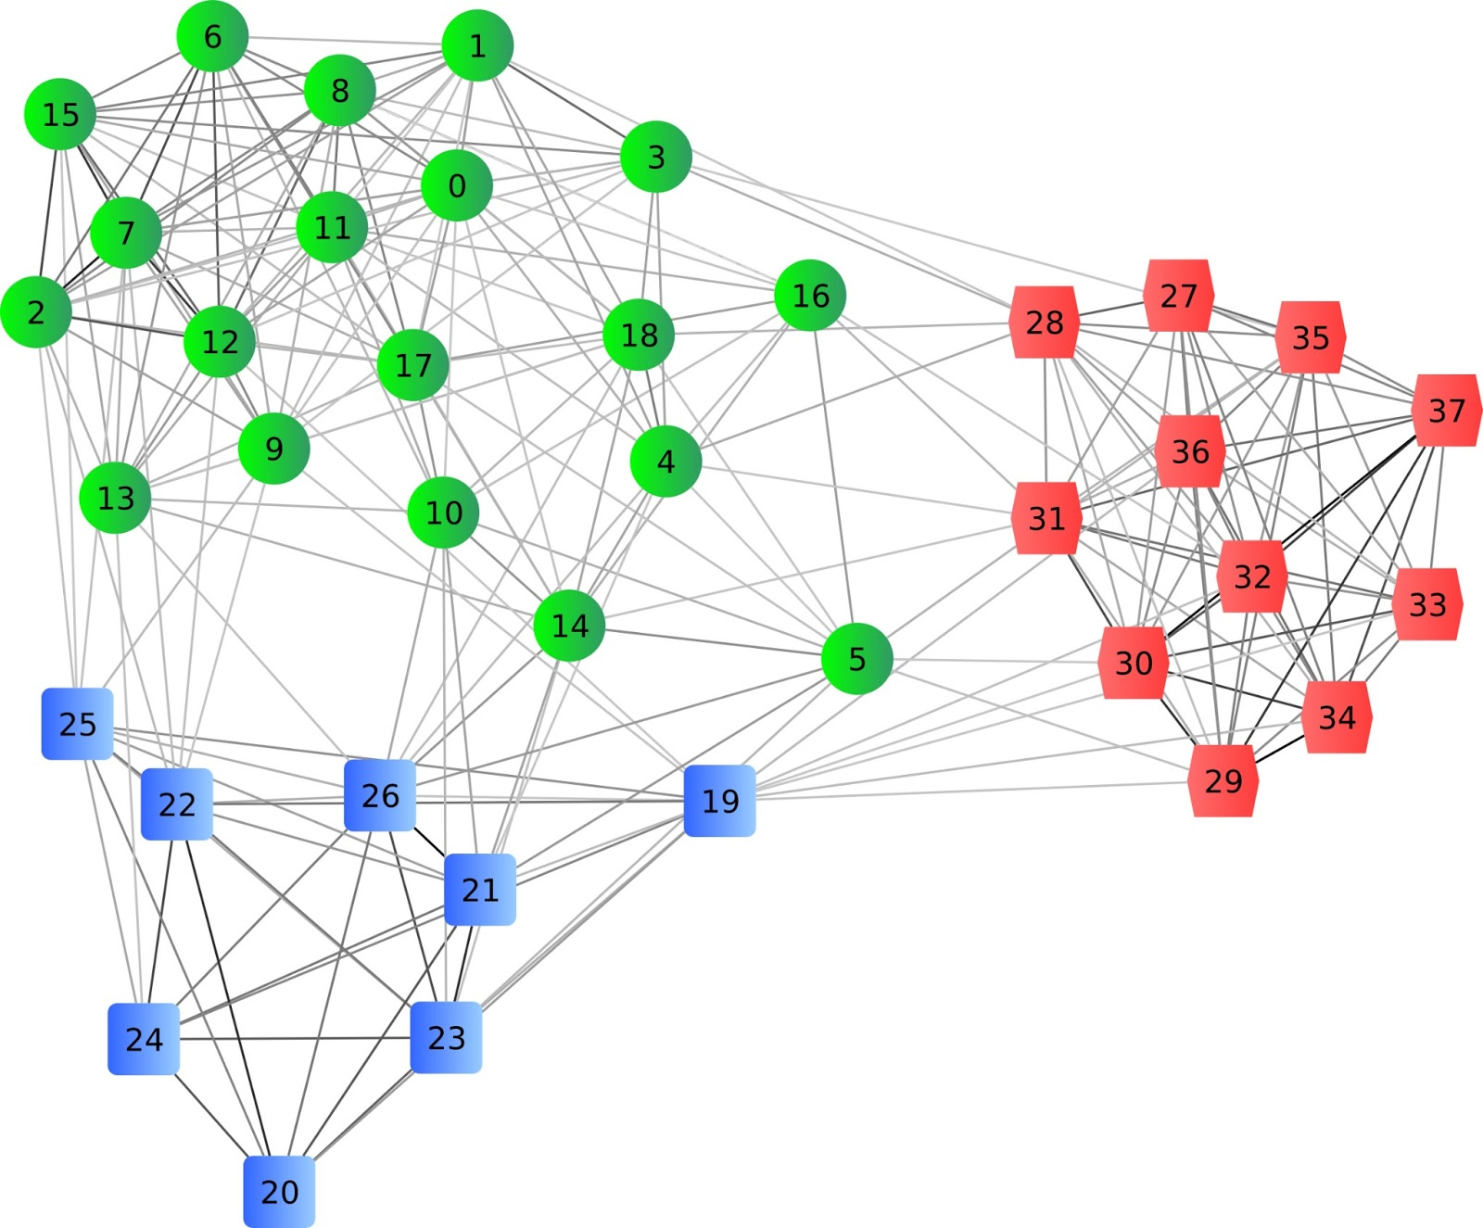
Hypothesis: Clustering similar employees by title, function, access, and security profiles will allow us to determine all access requirements for new employees
Do I have to request access?

